Slide 1
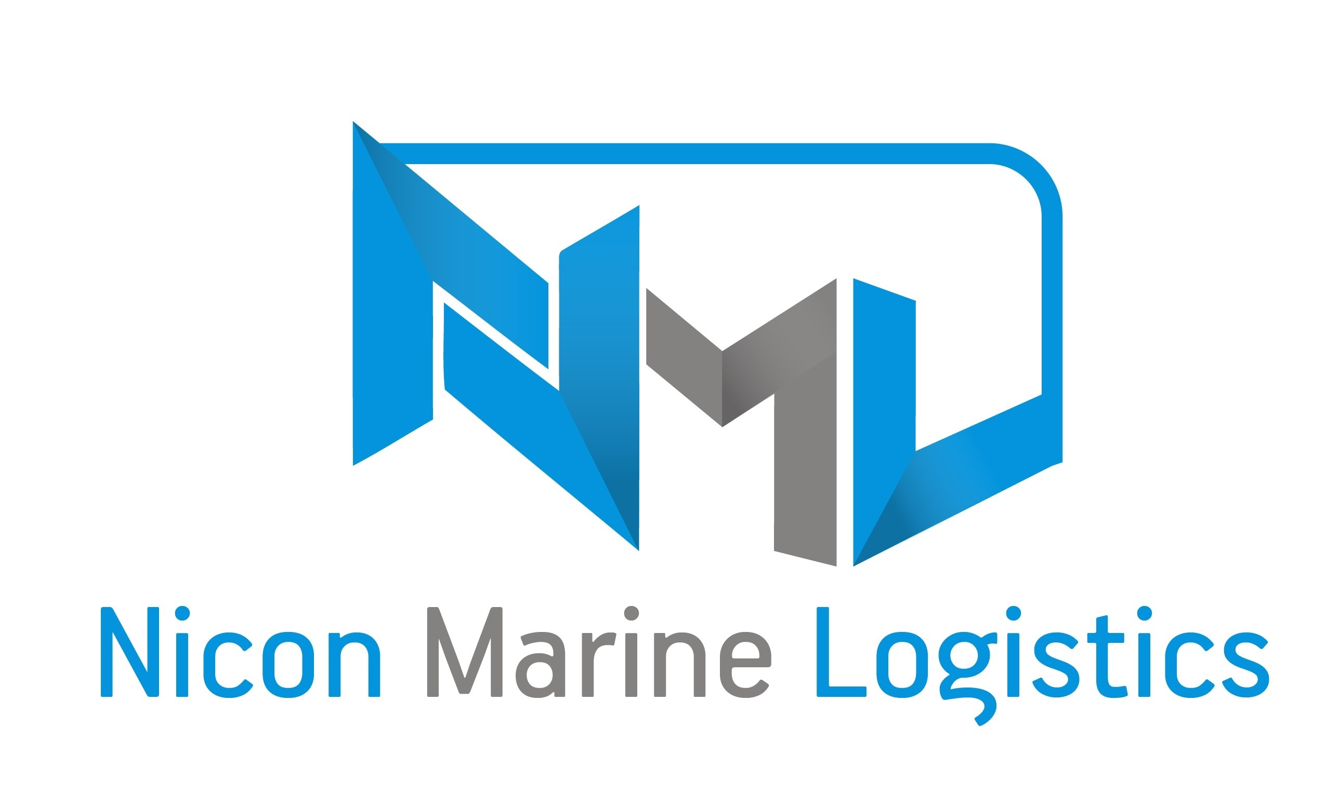
(One stop logistics solution for customer needs)

Slide 2
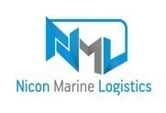
Why NML? Our mission is to support the needs of the logistic industry's supply chain with a comprehensive suite of forward-thinking and cost -effective services through network of both Indian and overseas location and We manage our operation and services with honesty , efficiency . NML is an emerging logistics company in Chennai our line of business NVOCC , Freight Forwarding, Container Trading, Container leasing and Transportation.
Nicon Marine logistics Pvt ltd
(One stop logistics solution for customer needs)
NML is Your Trustworthy Partner

Slide 3
Nicon Marine logistics Pvt ltd
(One stop logistics solution for customer needs)
ABOUT NML
Our mission
We are Over 10+ years of industry experience persons in NML
We are great pleasure in offering its services in the area of logistics thus contributing towards the growth of the nation.
NML is one stop source for all worldwide moving services.
We are dedicated in finding solutions to our customers’ problems whether they are big or small.
Our reputation & credibility in the market provides to work with some of the biggest names in the industry.
A trustworthy family, dedicated specialists eager to solve customers’ sourcing and inventory management problems.
"Let us build Trust in each other, Close relationship with High Integrity in business."
NML is Your Trustworthy Partner

Slide 4
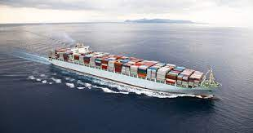
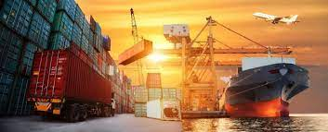
Core Area of Business
Nicon Marine logistics Pvt Ltd
(One stop logistics solution for customer needs)

Slide 5
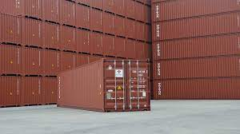
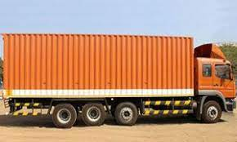
Core Area of Business
Nicon Marine logistics Pvt Ltd
(One stop logistics solution for customer needs)

Slide 6
NVOCC (Non – Vessel Operating Common Carriers) We offer services across the Indian subcontinents, middle East , upper gulf and far East location . we have container inventory at all major port meet our clients requirements including Dry Containers & Special Equipment's. Our strong and reliable network of agents helps in connecting the containers to various destination.
Nicon Marine logistics Pvt Ltd
(One stop logistics solution for customer needs)

Slide 7
CONTAINER TRADING We Buy & Sell used or new shipping world wide in all type like dry van , Refrigerated & Special containers and supplying quality containers as per customer needs and standard. We do additional services like CSC Certification Survey Reports and we ensure better service to our customer
Nicon Marine logistics Pvt Ltd
(One stop logistics solution for customer needs)

Slide 8
FORWARDING We Provide freight forwarding service for all type of cargo with no restriction as to size , weight , location and mode of transport. Our expert provide a complete range of service that include import and export logistics for time sensitive , cost – sensitive ocean shipments. We offer Quality forwarding , cost effective and customize logistic solution to meet there customer requirements.
Nicon Marine logistics Pvt Ltd
(One stop logistics solution for customer needs)

Slide 9
LEASING Nicon Marine offer domesticated ( Duty paid ) Cargo worthy & IICL Container on lease / rental for domestic use (Static Storage , Transport ETC )… Our Container inventory consists of all type and available all major ports across various location to meet our customer demands.
Nicon Marine logistics Pvt Ltd
(One stop logistics solution for customer needs)

Slide 10
TRANSPORTATION We have vast experience in domestic transportation ( BY Road ,Rail & Air ). We doing Project cargo distribution across India Expertise in transport management and planning allows us to design a solution that meet various customer need s and cost effective , Safety etc..
Nicon Marine logistics Pvt Ltd
(One stop logistics solution for customer needs)

Slide 11
# Office Address 102 2nd floor 2nd Street , AC Block Anna Nagar, Chennai – 600040 Phone: +91-9551271999 /+91-98403 90050 Email: For Sales: info@niconmarine.com For Website : www.niconmarine.com
Nicon Marine logistics Pvt Ltd
(One stop logistics solution for customer needs)

Slide 12
THANK YOU
Nicon Marine logistics Pvt Ltd
(One stop logistics solution for customer needs)

